Slide 1
People & Talent Acquisition
Lauren Darby & Diego Ancira

Slide 2
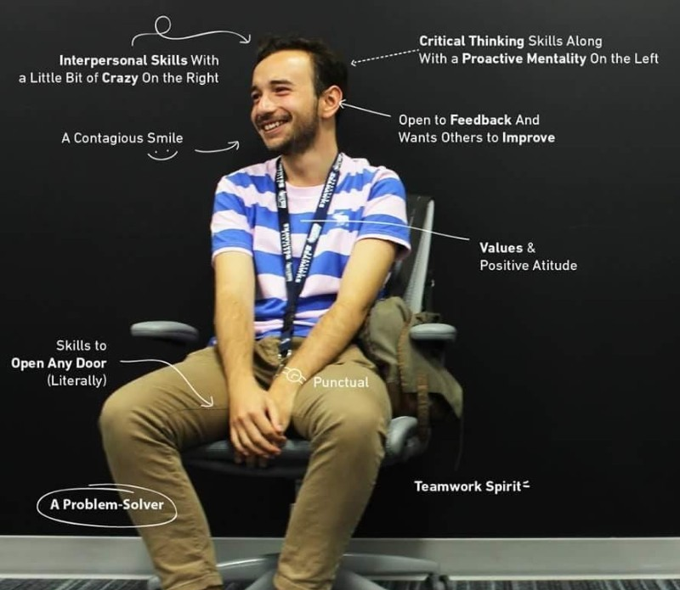
Excited to be here!!
With 8+ years of experience in Talent Acquisition and HR, Diego has worked with teams in the US, UK, and LatAm at several companies, including Revolut, Flex, AstraZeneca, and HPE.
Led two company hiring ramps and several Employee Resource Groups (ERGs) — volunteer groups organized by teams to promote diversity and inclusion in the workplace —for women in tech and mental health awareness.

Slide 3
Hiring Strategy
Inbound vs Outbound Recruitment
Careers site job postings
Job Boards –
Partnerships with Universities for job fairs, internships, guest speaking, competitions, and more
Active sourcing and Sourcing Parties
Notes:
Any programs that offer certs?
Analytics majors
Bill talking about sales degree program at OU

Slide 4
Kickoff Form
Standardizing process
Job Opening Request
Steps to follow
Interview Process
What we do and what you can expect
Referral Bonus

Slide 5
Job opening Request
Resource Request Received
a. Fill out the Kickoff form, by this point you should have the Job Description ready
b. Request to begin recruiting/hiring for a specific role comes
c. Received by Diego Ancira and Lauren Darby
Clarify Request
a. Talent Acquisition or People responds back to business and loops in Matt
b. Business clarify the desired resource need and what the hire is for (i.e. capability expansion, specific pursuit, sold work, hiring for growth, etc.)
c. Upon receiving this clarification, Matt may deny request right away or tell business/people team to proceed with defining the hiring need

Slide 6
Job opening Request
Job Requisition Review - Assuming the request goes forward
a. Once the job posting is built out, Matt/People Team to review and determine an estimate of the final cost of the employee (and US/MX hiring profile)
b. This will be coupled with the continued evolution of the needs at the Company based on recent wins, project shifts, etc.
c. Talent Acquisition conducts a Kickoff session with the previous form filled
d. Upon this review, we determine to post the job and move forward or Matt goes back to business team to push back and ask questions

Slide 7





Standard Interview Process
Introduction Call
(~30-45 minutes)
Agenda:
Overview of Interview Process
Candidate Questions
Facilitator: Diego
Technical Skills Interview
(~30-45 minutes)
Agenda:
TBD
Facilitator: Hiring Manager
Business Process Interview
(~30-45 minutes)
Agenda:
Sales Processes
Marketing Processes
Customer Success Processes
Facilitator: Business
Skills Interview
(~30-45 minutes)
Agenda:
Client Relations
Presentation Skills
Facilitator:
Feedback Loop
Either send “Thank You” email OR make offer (with call as needed)
Facilitator: Diego
If a candidate is disqualified at any point during these three interviews, proceed immediately to the end

Slide 8
Kickoff form LINK
Document every requisition we are posting and approving
Better understanding of what the team needs before the launching sessions
Have me, the team or future TA members be prepared and gather information about roles, market insights

